Slide 1
AUTOMATED QUESTIONAIRRE-ANSWER SYSTEMS FOR EDUCATIONAL TEXTS
BY: DRASHTI PATEL

Slide 2
AGENDA OVERVIEW
01
05
PROBLEM STATEMENT
EVALUATION METRICS
02
06
MOTIVATION
RESULTS
03
07
METHODOLOGY
ANALYSIS DRAWN
04
08
EXPERIMENTS
CONCLUSION

Slide 3
PROBLEM STATEMENT
How to generate contextually relevant , high-quality question-answer pairs ?
Primary focus on “Educational Domain” rather than focussing on the broader spectrum.
How to automate the process for contextually relevant + semantically accurate results?
Bridge the gap between the growing demand for high-quality educational resources and the limitations of manual content creation.
Current solutions fall short in providing scalable and accurate systems for generating high-quality, contextually relevant assessments.

Slide 4
MOTIVATION
1.Effort to reduce the substantial manual labour
(time-consuming + resource-intensive for generation.)
2.Automation can streamline assessment creation, benefiting:
Educators: Saves time and effort.
Learners: Delivers better, more targeted assessments.
3.Growing volume of digital educational content demands scalable solutions.
Thus, the need for an automated approach for educational material generation arises.

Slide 5
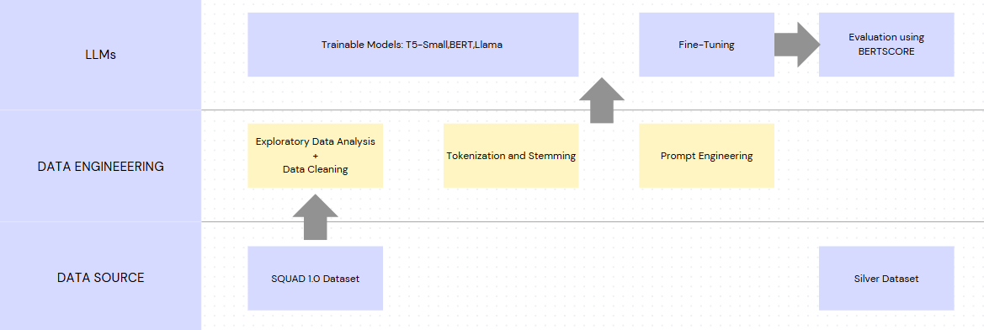
METHODOLOGY
FLOW DIAGRAM OF METHOD USED IN RESEARCH

Slide 6
DATASET EMPLOYED
SQUAD (STANFORD QUESTION ANSWERING DATASET
SILVER-STANDARD DATASET
OTHER DATASETS WHICH CAN BE USED IN FUTURE
100,000+ question-answer pairs
Large Scale Data
Created from educational text excerpts covering topics such as machine learning, neural networks, optimization algorithms, and regularization techniques
150 rows of data
1.Natural Questions (NQ)
2.TriviaQA
3.NewsQA

Slide 7
SQUAD 1.0 DATASET
Column | Description
id | Unique identifier for each question-answer pair.
title | Title of the Wikipedia article from which the context is extracted.
context | The passage containing the answer, preprocessed (e.g., lemmatized, stop words removed).
question | The query related to the context, preprocessed similarly to the context.
answers | Dictionary with keys:- text: List of answer strings.- answer_start: List of starting character indices of each answer in the original context.
Reading comprehension dataset consisting of questions posed by crowdworkers on a set of 500+ Wikipedia articles. The answer to every question is a segment of text, or span, from the corresponding reading passage.
PREPROCESSING
1.Tokenisation and lemmatization of words (convert to their base form)
2.The context and question fields of the dataset are cleaned ensuring cleaner ,optimized output for model input.
3.Reduced noise
Dataset link: Drashtip/preprocessed_squad
Training Set: 87,599 examples
Validation Set: 10,570 examples

Slide 8
SILVER DATASET
Input :Diverse source of pdf texts pertaining to Machine learning, Artificial Intelligence, Data Science, neural networks and related topics.
2. Fed to GPT to generate relevant context , question, answer columns of data .
Output: Silver Dataset (150 rows)
Need of leveraging this dataset?
For testing educational texts

Slide 9
EXPERIMENTS
Experimented with three transformer-based models—
1.T5-Small
2. BERT-base-uncased
3. LLaMA 3.2-3B-Instruct
The models were fine-tuned on the SQuAD dataset.
.

Slide 10
MODEL 1-T5 SMALL MODEL
(ENCODER-DECODER (SEQUENCE-TO-SEQUENCE))
1.Combine context and question into a formatted text input: "context: {context} question: {question}".
2. Convert the input text into token IDs using the T5 tokenizer.
3.Encoder: Process the input tokens with self-attention layers to generate contextualized embeddings capturing the semantic meaning of entire input.
4.Decoder: Use cross-attention to focus on encoder outputs and autoregressively generate the answer token by token.
Takes encoders output as input + previously generated tokens (for sequential token generation), and generates one token at a time leading to final generated text .

Slide 11
MODEL 2-BERT MODEL
(ENCODER-ONLY TRANSFORMER, FINE-TUNED FOR SEQUENCE TASKS)
1.Prepare the input as [CLS] question [SEP] context [SEP] and tokenize it using BERT tokenizer .
2.Pass the tokenized input through BERT to generate contextual embeddings ,capturing meanings.
3.BERT uses two output layers:
Start Layer: Predicts the token where the answer starts.
End Layer: Predicts the token where the answer ends.
Use the QA head to predict start and end positions of the answer within the context.
The span between these indices is the predicted answer.
4.During training, minimize cross-entropy loss for start and end positions.
5.During inference, select tokens with the highest start and end logits and decode them into the final answer

Slide 12
MODEL 3-LLAMA MODEL
(BEST PERFORMING MODEL-DECODER ONLY )
Designed for instruction-based fine-tuning, making it ideal for generating question-answer pairs from context.
1.The input is formatted as a structured prompt, combining the task instruction and context.
2.Converts the input text into token IDs using the LLaMA tokenizer.
3.Decoding:
The model processes the input prompt and generates the output token by token in an autoregressive manner:
The model predicts the first token of the output .
Using the input prompt and the first token. it predicts the next token.
This continues until the model generates a complete sequence or reaches a stop token.
4.Instruction Tuning:Parse the instruction + input context , generate output to align with the task.
5.The model generates a complete question-answer pair in a coherent and contextually relevant format.

Slide 13


MODEL COMPARISIONS
T5-Small:
Performs well in generating fluent, simple questions.
Lacks diversity in generated question formats.
Suitable for smaller datasets and limited computation tasks.
BERT:
Stronger at extracting accurate answers with high semantic precision.
Limited ability for generating diverse and complex question-answer pairs.
LLaMA 3.2-3B:
Outperforms both models in semantic richness and contextual relevance.
Best suited for combined question and answer generation tasks but demands higher computational resources. give this in visualisation form

Slide 14
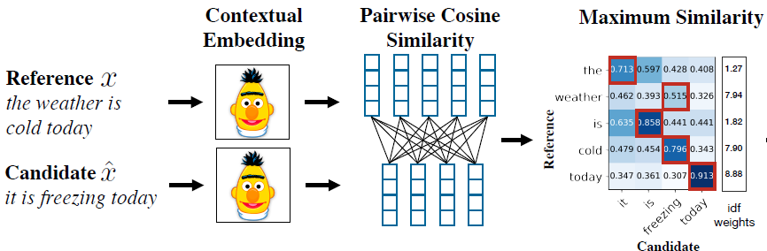
EVALUATION METRICS: BERTSCORE
1.Both the generated and reference texts are tokenized and passed through a pre-trained BERT model to generate contextual embeddings.
2.For each token in the generated text, cosine similarity is computed with every token in the reference text to find the best match.
Precision: Measures how much of the generated text aligns with the reference.
Recall: Measures how much of the reference is covered by the generated text.
F1 Score: Balances precision and recall for an overall evaluation.

Slide 15

RESULTS
Performed well but generates repetitive patterns.
Moreover, being a small model it is used for computationally small generation.
Inferences:
Fairly good results with highest average BERTScore F1
Model | Metric | 100 Sample Result | Entire Validation Dataset
Fine-tuned T5-small | Average BERTScore F1 | 0.8244 | 0.8253
 | Average BERTScore Precision | 0.8145 | 0.8199
 | Average BERTScore Recall | 0.8351 | 0.8322
Fine-tuned BERT | Average BERTScore F1 | 0.7648 | 0.7701
 | Average BERTScore Precision | 0.7049 | 0.7215
 | Average BERTScore Recall | 0.8361 | 0.8259
Fine-Tuned Llama | Average BERTScore F1 | 0.7849 | 0.7892
 | Average BERTScore Precision | 0.7257 | 0.7312
 | Average BERTScore Recall | 0.8548 | 0.8574

Slide 16
RESULTS
Model | Metric | 100 Sample Result | Entire Validation Dataset
Fine-tuned T5-small | Average BERTScore F1 | 0.8244 | 0.8253
 | Average BERTScore Precision | 0.8145 | 0.8199
 | Average BERTScore Recall | 0.8351 | 0.8322
Fine-tuned BERT | Average BERTScore F1 | 0.7648 | 0.7701
 | Average BERTScore Precision | 0.7049 | 0.7215
 | Average BERTScore Recall | 0.8361 | 0.8259
Fine-Tuned Llama | Average BERTScore F1 | 0.7849 | 0.7892
 | Average BERTScore Precision | 0.7257 | 0.7312
 | Average BERTScore Recall | 0.8548 | 0.8574
Demonstrates better semantic precision than T5-Small but is limited in handling more diverse question types.
Inferences:
Lowest Average BERTScore F1 and Precision

Slide 17
RESULTS
Model | Metric | 100 Sample Result | Entire Validation Dataset
Fine-tuned T5-small | Average BERTScore F1 | 0.8244 | 0.8253
 | Average BERTScore Precision | 0.8145 | 0.8199
 | Average BERTScore Recall | 0.8351 | 0.8322
Fine-tuned BERT | Average BERTScore F1 | 0.7648 | 0.7701
 | Average BERTScore Precision | 0.7049 | 0.7215
 | Average BERTScore Recall | 0.8361 | 0.8259
Fine-Tuned Llama | Average BERTScore F1 | 0.7849 | 0.7892
 | Average BERTScore Precision | 0.7257 | 0.7312
 | Average BERTScore Recall | 0.8548 | 0.8574
LLaMA outperforms the other models in generating contextually rich and semantically accurate question-answer pairs due to its larger size and instruction-based fine-tuning.
Inferences:
Highest Average BERTScore Recall!

Slide 18
TEST RESULTS ON SILVER DATASET
Model | Metric | Silver dataset
Fine-tuned T5 | Average BERTScore F1 | 0.8306
 | Average BERTScore Precision | 0.8389
 | Average BERTScore Recall | 0.8229
Fine-tuned BERT | Average BERTScore F1 | 0.8187
 | Average BERTScore Precision | 0.8127
 | Average BERTScore Recall | 0.8249
Fine-Tuned Llama | Average BERTScore F1 | 0.8019
 | Average BERTScore Precision | 0.7472
 | Average BERTScore Recall | 0.8653

Slide 19
ANALYSIS DRAWN
1.Even though Llama provides best results in terms of Q-A Generation, it requires very high computational resources .
Time to fine-tune was excessively high : Around 6-7 hours
Other models:
T5-Small :1 hour(CPU)
BERT: Around 3 hours(CPU)
2.The BERTScore vs LLAMA trade off
Low BERTScore for Llama?
This is due to the nature of BERTScore and how it evaluates similarity.
BERTScore may fail to recognize paraphrases accurately, especially if the embedding similarity does not capture nuanced relationships
BERTScore might underperform unless the embeddings fully capture the semantic equivalence.
Our model generates creative and divergent outputs which are valid but not closely aligning with reference and get penalised by BERTScore .

Slide 20
ANALYSIS DRAWN
The question answers generated by T5-Small and BERT were of similiar nature.
1. What is the main topic of the text?
2. How is machine learning related to walking?
3. What is the role of random change in evolution?
4. What is the term used to describe the process of a machine learning algorithm moving down the slope of a loss function to find the minimum?
5. What is the role of the gradient in the Gradient Descent algorithm?
1. The main topic of the text is machine learning and its connection to evolution.
2. Machine learning can copy the pattern of walking.
3. Random change is encouraged by feedback to help evolution go in the right direction.
4. The term used to describe the process of a machine learning algorithm moving down the slope of a loss function to find the minimum is called Gradient Descent.
5. The gradient is used in the Gradient Descent algorithm to determine the local slope of the loss function at the current weights. This information is used to make small adjustments to the weights in the direction that decreases the loss.
*These texts have been generated by giving a machine _learning chapter pdf as input

Slide 21
ANALYSIS DRAWN
Llama Results were as follows:
1. What is the main idea of the chapter on Machine Learning?
2.What is the difference between mean and median?
3. What is the standard deviation of visits to the library in the page 2?
4. What are the three main types of descriptive statistics?
5.What is the formula for finding the standard deviation?
1.The main idea of the chapter on Machine Learning is that computers can learn from lots of data and trial and error, and this process is similar to how brains evolved over billions of years.
2.The mean is the average of all values in a dataset, while the median is the middle value when the data is arranged in order.
3.The standard deviation of visits to the library in the past year is 1.6, as shown in the table below.
Visit | Frequency | Standard Deviation |
|--- | --- | --- |
| 1 | 2 | 1.2 |
| 2 | 3 | 1.1 |
| 3 | 4 | 1.3 |
4.The three main types of descriptive statistics are:
1. Distribution: This type of statistics deals with the frequency of each value in a dataset.
2. Central tendency: This type of statistics deals with the averages of the values in a dataset.
3. Variability or dispersion: This type of statistics deals with how spread out the values are in a dataset.
5.The formula for finding the standard deviation is: SD = √[(Σ(xi - μ)²) / (N - 1)], where xi is each individual data point, μ is the mean of the dataset, and N is the total number of data points.

Slide 22
CONCLUSION
1.Successful comparisions of the models employed.
2. Highly rich question-answer pair generation with both T5-Small and Llama model , with the latter being able to produce more semantically rich and diverse outputs.
3.Future work can explore dataset diversity, efficient fine-tuning, and hybrid model strategies for enhanced scalability and adaptability.

Slide 23
THANK YOU!

Slide 24
WHY BERTSCORE?
BERTScore evaluates the semantic similarity of texts, rather than relying on exact word matches, making it ideal for tasks like question-answer generation.
Meaningful alignment between generated and reference outputs, outperforming traditional metrics like BLEU and ROUGE which match word to word.
Useful when capturing meaning is more important than exact word overlap.
Model Based metrics possess issue that they rely on other models.
BERTSCORE VS LLAMA
https://www.airtrain.ai/blog/the-comprehensive-guide-to-llm-evaluation

Slide 25
Semantically Rich Text:A question-answer pair is semantically rich when it captures deep, meaningful information from the context, providing a nuanced understanding of the content.
Q: "What was the purpose of the Apollo program, and who conducted it?"
A: "The Apollo program, conducted by NASA, aimed to carry out human spaceflights and landed astronauts on the Moon."
Syntactically Rich Text: A question-answer pair is syntactically rich when it demonstrates grammatically complex and well-structured sentences, emphasizing proper syntax and varied sentence construction.
Simple Syntax: "Who conducted the Apollo program?"
Syntactically Rich Syntax: "Can you elaborate on which organization was responsible for conducting the Apollo program?"
Decoding Methods :
T5 : Beam Search
BERT: Span Based Q/A
Llama :Greedy

